Slide 1
Network Performance and Recovery Session 12
Course:
ISYS6675003-Information Technology Infrastructure
Effective Period : September 2022

Slide 2
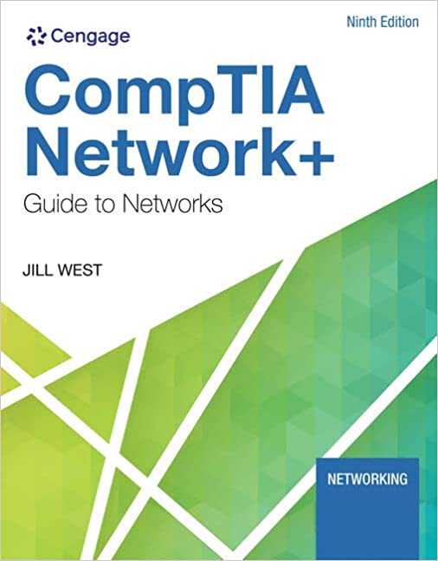
Acknowledgement
These slides have been adapted from:
CompTIA Network+ Guide to Networks
9th Edition
Author: Jill West
ISBN-13: 978-0357508138
ISBN-10: 0357508130
Chapter 11
Network Performance and Recovery

Slide 3
Student will be able to :
Learning Outcome
LO2: Explain Emerging Technologies in IT Infrastructure. (C2)
LO3: Analyze case study in IT Infrastructure. (C4)
LO4: Analyze solution business problems that require IT Infrastructure solutions. (C4)

Slide 4
After studying this chapter, student will be able to :
Learning Objectives
Use appropriate tools to monitor device and network events
Adjust device configurations to optimize network performance
Identify methods to increase network availability
Identify best practices for incident response and disaster recovery

Slide 5
Collecting Network Data
Network management
Assess, monitor, and maintain all network aspects
Network management can include:
Controlling user access to network resources
Checking for hardware faults
Ensuring optimized Q o S (quality of service) for critical applications
Maintaining records of network assets and software configurations
Determining what time of day is best for upgrading a router, server, or application
Goals:
Enhance efficiency and performance
Prevent costly downtime and loss
Predict problems before they occur

Slide 6
Monitoring Tools
Network monitor
Tool that continually monitors network traffic
Protocol analyzer
Tool that can monitor traffic at a specific interface between a server or client and the network
Difference:
Network monitor can monitor traffic that a single device encounters
Protocol analyzer can monitor traffic patterns throughout a particular network

Slide 7
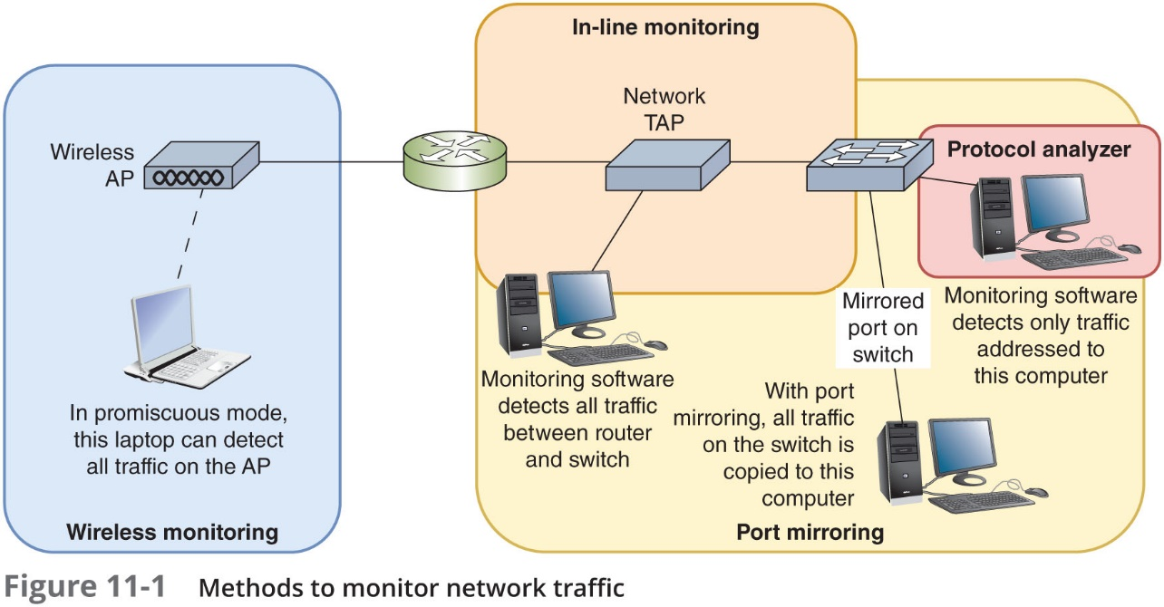
Monitoring Tools

Slide 8
Monitoring Tools
Wireless monitoring—Run monitoring software on a computer connected wirelessly to the network
Port mirroring—All traffic sent to any port on a switch can be sent to a mirrored port
Connect that port to a computer running monitoring software
In-line monitoring—Install a device, called a network TAP (test access point) or packet sniffer, in line with network traffic

Slide 9
Monitoring Tools
All network monitoring tools can perform the following functions:
Set the NIC to run in promiscuous mode to pass all traffic to the monitoring software
Continuously monitor network traffic on a segment
Capture network data transmitted on a segment
Capture frames sent to or from a specific node
Reproduce network conditions by transmitting a selected amount and type of data
Generate statistics about network activity

Slide 10
Monitoring Tools
Some network monitoring tools can also perform the following functions:
Discover all network nodes on a segment
Establish a baseline, including performance, utilization rate, and so on
Track utilization of network resources and device resources and report it in graphs or charts
Store traffic data and generate reports
Trigger alarms for certain preconfigured conditions
Identify usage anomalies, such as top talkers or top listeners

Slide 11
Monitoring Tools
Monitoring tools can help identify the following:
Runts
Giants
Jabber
Ghosts
Packet loss
Discarded packets
Interface resets
Alerts might be transmitted by email or text
Called SMS (Short Message Service)

Slide 12
System and Event Logs
Log
Contains recorded conditions recognized by operating system
Event log
Windows-based computer log containing monitored device information
Event Viewer application
Application to view log information in Windows

Slide 13
System and Event Logs
Syslog function:
Standard for generating, storing, and processing messages about events on Linux or UNIX
Data written to system log
Syslog defines roles for each computer that participates in logging:
Generator—Computer that is monitored by a syslog-compatible application and issues event information
Collector—Computer that gathers event messages from generators

Slide 14
System and Event Logs
Table 11-1 Linux and UNIX system log locations
Version type | System log location
Newer versions of Linux | /var/log/messages
Older versions of UNIX | /var/log/syslog
Solaris versions of UNIX | var/adm/messages

Slide 15
System and Event Logs
Using logs for fault management:
Logs keep history
Logs must be monitored for errors
Most UNIX and Linux OSs provide a GUI application used for viewing and filtering information
Other applications are available for sifting through syslog data and generating alerts

Slide 16
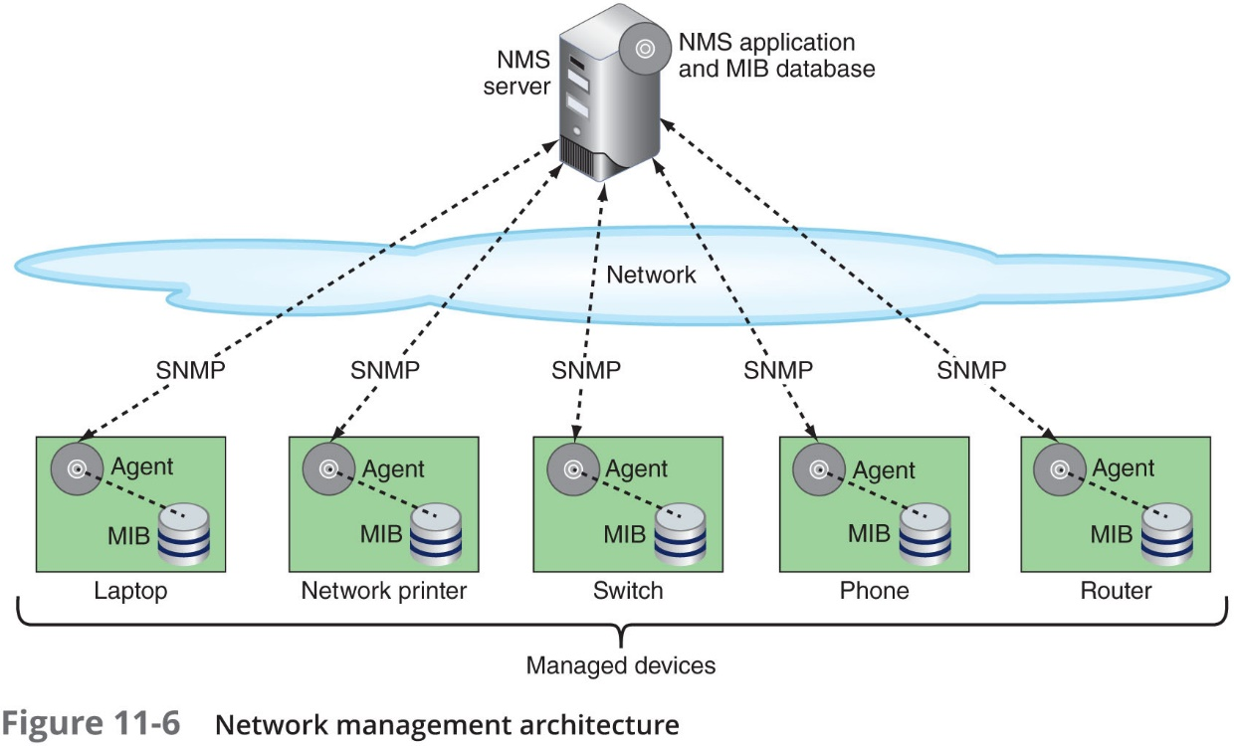
SNMP Logs
Enterprise-wide network management systems:
Accomplish fault and performance management
All use similar architecture

Slide 17
SNMP Logs
NMS (network management system)
Collects data from multiple managed devices at regular intervals in a process called polling
Managed device
Any network node monitored by the NMS
Network management agent:
Software routine that collects information about device’s operation
Provides information to the NMS
MIB (Management Information Base):
Contains managed devices definition, data
Designed in a top-down, hierarchical tree structure

Slide 18
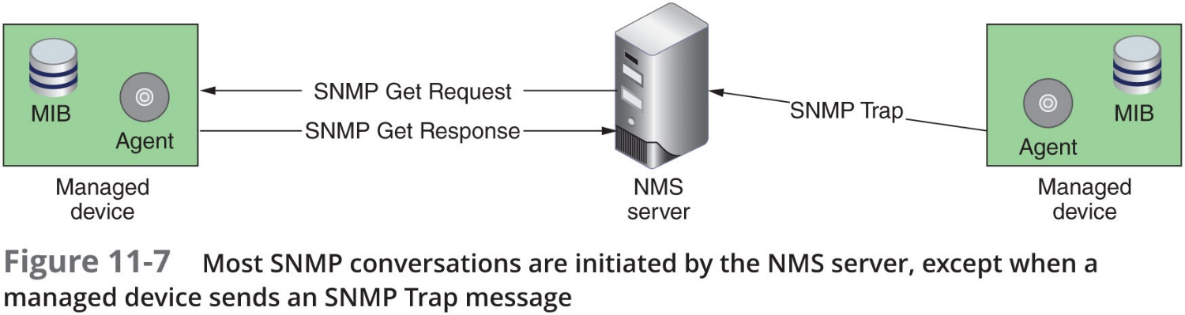
SNMP Logs
SNMP (Simple Network Management Protocol):
Used to communicate managed device information
Part of TCP/IP suite
SNMPv3: Most secure version of the protocol
SNMPv2: Still widely used
SNMPv1: Original version; rarely used today

Slide 19
SNMP Logs
Network management applications:
Flexible
Challenging to configure and fine-tune
Choose correct type and amount of information to collect

Slide 20
Performance Baselines
Baseline
Report of network’s current operation state
Example baseline measurements:
Network backbone utilization rate
Number of users logged on per day or per hour
Number of protocols running on network
Error statistics
Runts, jabbers, or giants
Frequency of application use
Bandwidth usage

Slide 21
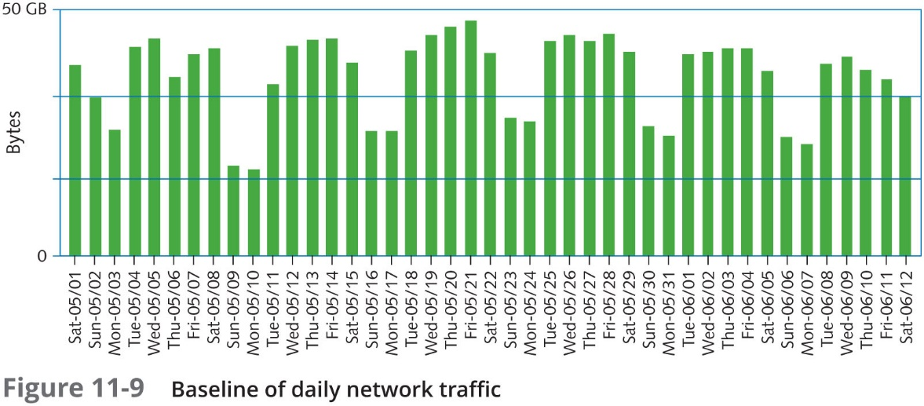
Performance Baselines

Slide 22
Performance Baselines
Compare future and past performances:
Most critical network, user functions
More data provides more accuracy
Gathering baseline data:
Software applications (freeware)
Expensive, customizable hardware and software
Common performance metrics:
Utilization
Error rate
Packet drops
Jitter

Slide 23
Managing Network Traffic
Monitoring network’s status includes two major factors:
Performance management
Monitor links and devices’ ability to keep up with demand
Fault management
Detection and signaling of device, link, component faults

Slide 24
Traffic Management
Traffic shaping (packet shaping):
Manipulating packet, data stream, and connection characteristics
Manage type and amount of traffic traversing network
Goals
Assure timely delivery of most important traffic
Offer best possible performance for all users
Traffic shaping can involve:
Delaying less important traffic
Increasing priority of more important traffic
Limiting traffic volume flowing in and out of interface during specified time period
Limiting momentary throughput rate for an interface
Last two techniques above are known as traffic policing

Slide 25
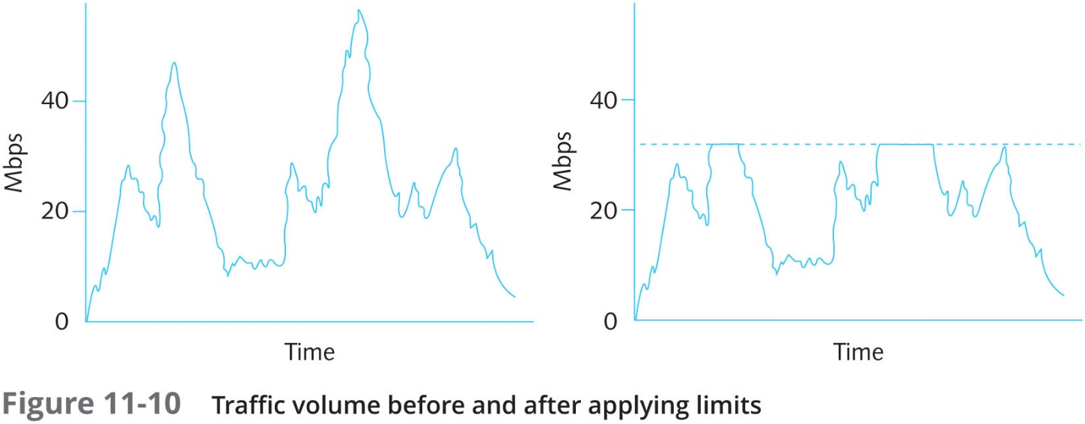
Traffic Management

Slide 26
Traffic Management
Traffic prioritization
Treating more important traffic preferentially
Prioritization based on characteristics:
Protocol
IP address
User group
DiffServ (Differentiated Services) flag in an IP packet
VLAN tag in Data Link layer frame
Service or application

Slide 27
QoS (Quality of Service) Assurance
VoIP, video over IP transmission are considered delay-sensitive
Caused by connection’s inconsistent QoS
Preventing delays, disorder, and distortion
Requires more dedicated bandwidth
QoS—A group of techniques for adjusting the priority a network assigns to various types of transmissions
Optimized QoS: Uninterrupted, accurate, and faithful reproduction
Improvements have been made to address QoS challenges
DiffServ and CoS—Covered next

Slide 28
DiffServ
(Differentiated Service)
Addresses QoS issues through traffic prioritization at Layer 3
DiffServ
Accounts for all network traffic
Can assign different streams different priorities
To prioritize traffic:
IPv4 datagram: DiffServ field
IPv6 datagram: Traffic Class field

Slide 29
DiffServ
(Differentiated Service)
Two forwarding types
EF (Expedited Forwarding):
Data stream assigned minimum departure rate
Circumvents delays
AF (Assured Forwarding):
Data streams assigned different router resource levels
Prioritizes data handling
No guarantee of on time, in sequence packet arrival

Slide 30
CoS (Class of Service)
CoS:
Refers to techniques performed at Layer 2 on Ethernet frames
Most often used to route Ethernet traffic between VLANs
Priority Code Point (PCP)
A 3-bit field in the frame header of a frame that has been tagged (addressed to a specific VLAN)
CoS sets these bits to one of eight levels ranging from 0 to 7
A network’s connectivity devices and clients must support the same set of protocols to achieve their QoS benefits
Networks can combine multiple QoS techniques

Slide 31
Network Availability
Availability
How consistently and reliably a file or system can be accessed
HA (high availability)
Refers to a system that functions reliably nearly all the time
Uptime
Measure of time functioning normally between failures
Linux or UNIX command uptime
Microsoft utility found in Task Manager

Slide 32
Fault Tolerance
Capacity for system to continue performing
Despite unexpected hardware, software malfunction
Failure
Deviation from specified system performance level
Given time period
Fault:
Malfunction of one system component
Can result in failure
Fault-tolerant system goal
Prevent faults from progressing to failures

Slide 33
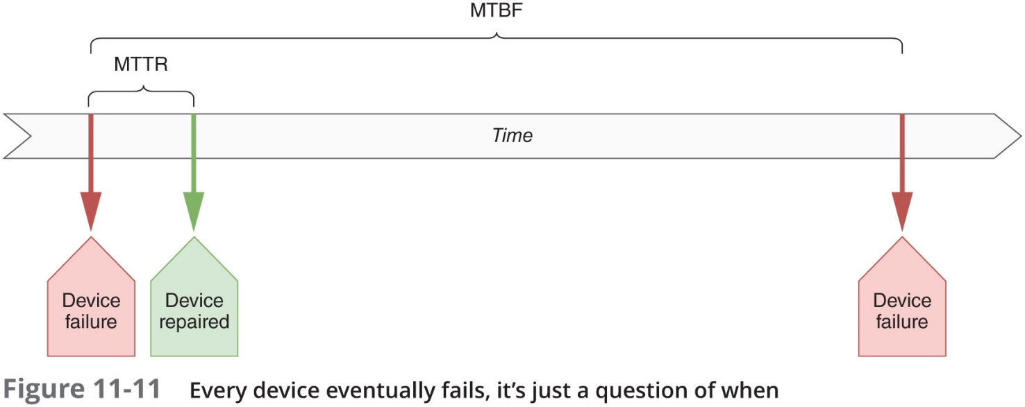
Fault Tolerance
Redundancy:
MTBF (mean time between failures)—Average amount of time that will pass for devices exactly like this one before the next failure is expected to occur
MTTR (mean time to repair)—Average amount of time required to repair the device

Slide 34
Fault Tolerance
Redundancy:
To help protect against faults and failures, network are often designed with two or more of the same item, service, or connection filling the same role on the network
If one part, service, or connection fails, the other takes over
To maintain high availability
Ensure critical network elements are redundant
Main disadvantage of redundancy:
Cost

Slide 35
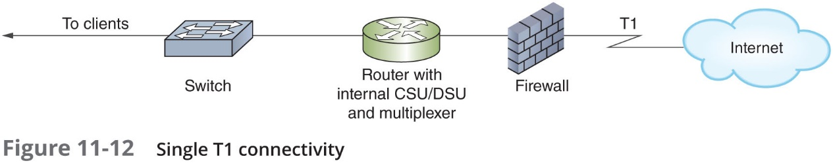
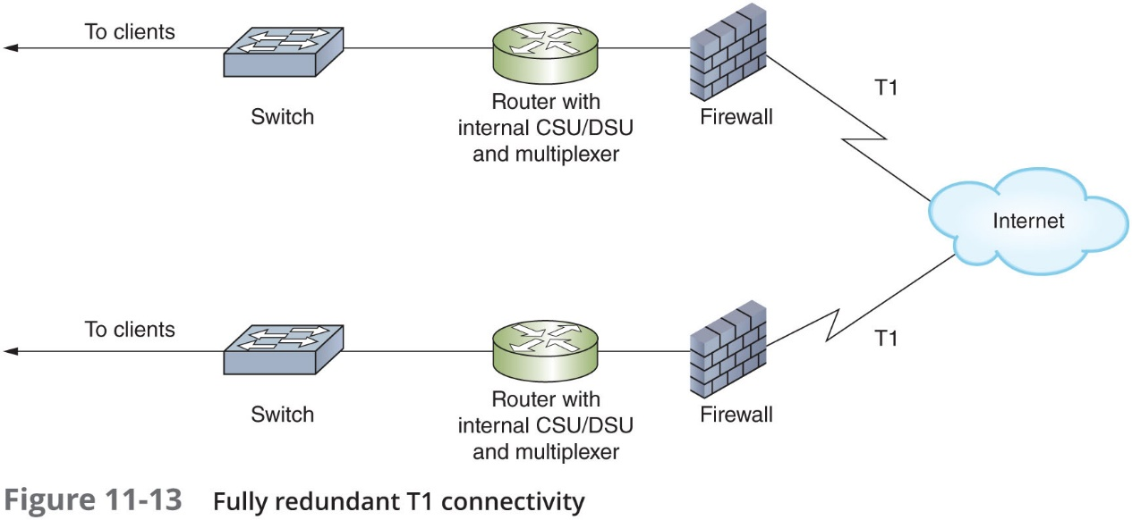
Fault Tolerance

Slide 36
Fault Tolerance
Automatic failover:
Critical devices require redundant NICs, SFPs, power supplies, cooling fans, and processors
Should have the ability to immediately assume the duties of an identical component
Hot-swappable
Refers to identical components that can be changed while a machine is running
Two approaches:
Hot spare—Duplicate component that is already installed in a device and can assume function in case the original component fails
Cold spare—Duplicate component that is not installed, but can be installed in case of a failure

Slide 37
Fault Tolerance
Link aggregation (port aggregation):
Combination of multiple network interfaces to act as one logical interface
Example: NIC teaming
Link aggregation allows for three major advantages:
Increased total throughput
Automatic failover between aggregated NICs
Load balancing—Traffic distribution over multiple components or links to optimize performance and fault tolerance

Slide 38
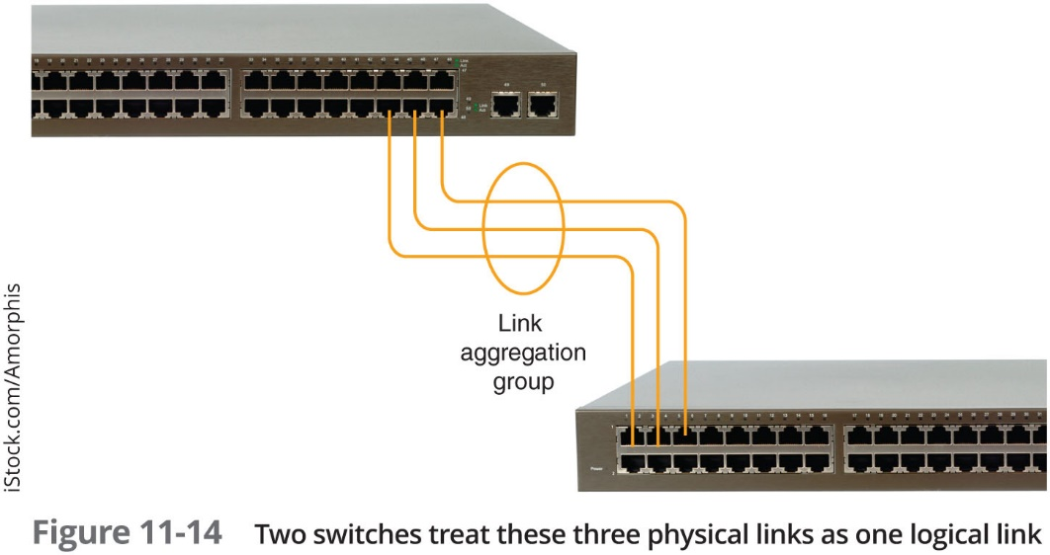
Fault Tolerance

Slide 39
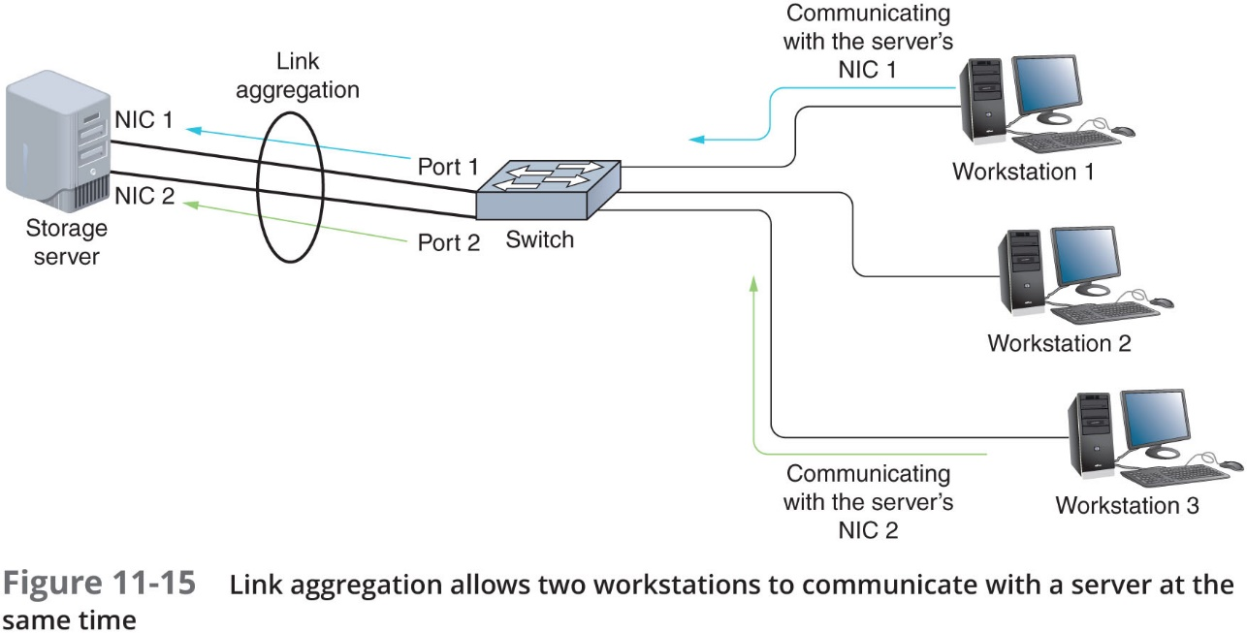
Fault Tolerance

Slide 40
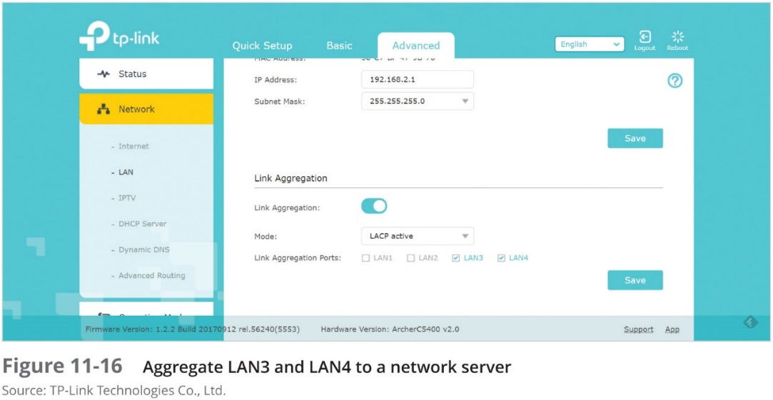
Fault Tolerance
LACP (Link Aggregation Control Protocol)
Dynamically coordinates communications between hosts on aggregated connections
Most of these devices offer similar configuration options:
Static configuration
Passive mode
Active mode

Slide 41
Fault Tolerance
Load balancer
A dedicated device that distributes traffic among multiple computers
Clustering:
The technique of grouping multiple devices so they appear as a single device
Usually accompanies load balancing
AVIP (virtual IP address) is used to represent the entire cluster
CARP (Common Address Redundancy Protocol):
Allows a pool of computers or interfaces to share one or more IP addresses
Pool is known as a redundancy group

Slide 42
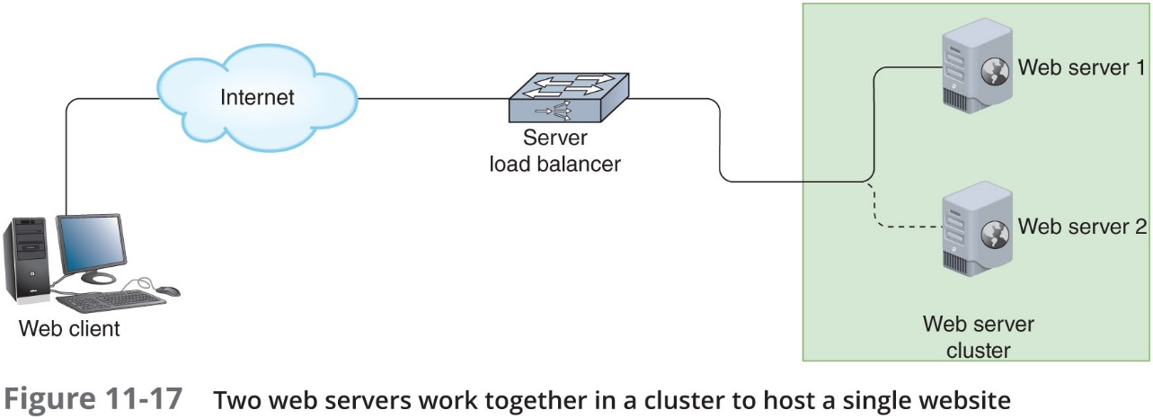
Fault Tolerance

Slide 43
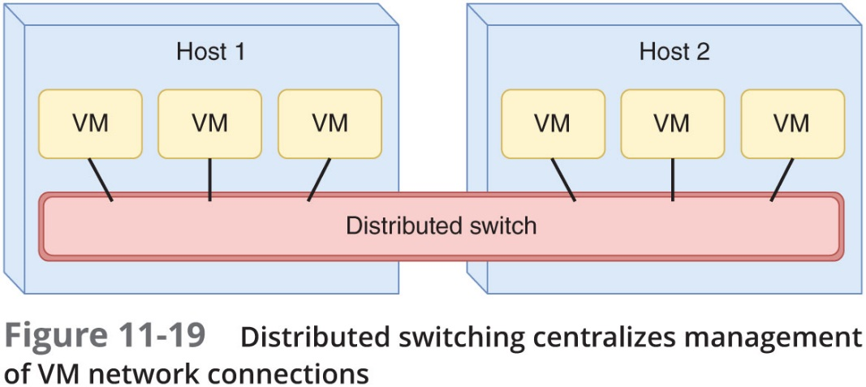
Fault Tolerance
Distributed switching:
Centralizes control of VMs
Simplifies network operations
Minimizes chances for configuration errors

Slide 44
Data Backup and Storage
Backup:
Copies of data or program files
Created for archiving, safekeeping
When creating a backup system, keep in mind:
Decide what to back up
Consider cloud backups
Verify backup hardware and software are compatible with network
Make sure backup software uses data error-checking
Verify that your backup storage media provides sufficient capacity
Be aware of how your backup process affects the system
Know how much the backup methods and media cost
Be aware of the degree of manual intervention required to manage backups

Slide 45
Data Backup and Storage
When creating a backup system, keep in mind (continued):
Make wise choices for storage media
When storing data to hard drives, recognize that drives can be installed on computers on the LAN
Keep backups secure
Decide what type of backup will be done
Full, incremental, or differential backups
Decide how often backups will be done
Develop a backup schedule
Establish a regular schedule of verification

Slide 46
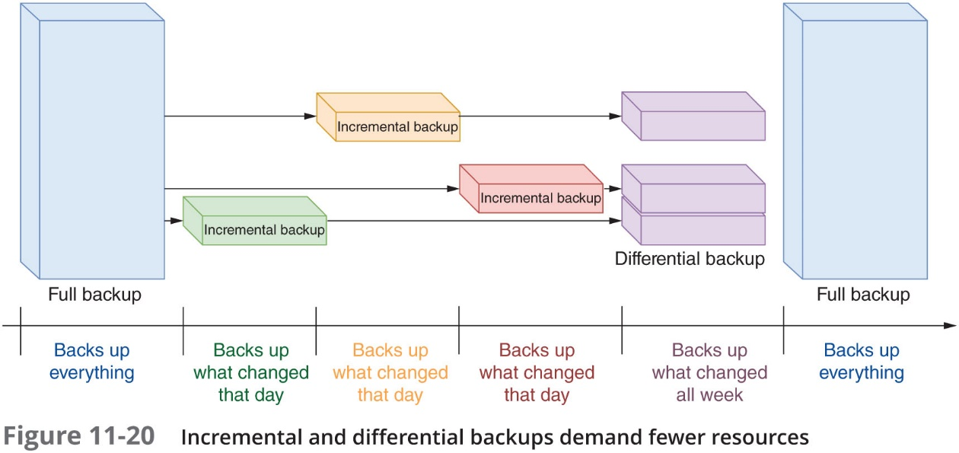
Data Backup and Storage
Snapshot
A frequently saved, incremental backup of the data’s state at a specific point in time

Slide 47
Data Backup and Storage
Network storage technologies
Provide hardware redundancy and high-speed access to large amounts of data
Differences between data backups and network storage technologies:
Network storage technologies don’t necessarily save multiple copies of the same data
Network storage technologies don’t usually store data in different geological locations
If there are multiple copies of the data, network storage technologies save those copies in the same format on the same type of media

Slide 48
Data Backup and Storage
NAS (network attached storage):
A specialized storage device or group of storage devices that provides centralized fault tolerant data storage for a network
Advantages:
Optimization—Contains its own file system optimized for saving and serving files
Adaptability—Can store and retrieve data for any type of client
Expansion—Can be easily expanded without interrupting service

Slide 49
Data Backup and Storage
NAS server’s pool of storage space is provided by multiple hard disk drives
Can be configured with a form of RAID (redundant array of inexpensive/independent disks)
Four most common types of RAID:
RAID 0—Data is striped/written across multiple disks
RAID 1—Data is mirrored/duplicated on multiple disks
RAID 5—Data is striped across three or more drives and parity information is added to the data
RAID 10—Data is mirrored within each pair of disks (uses four or more disks) and then striped to multiple pairs of disks

Slide 50
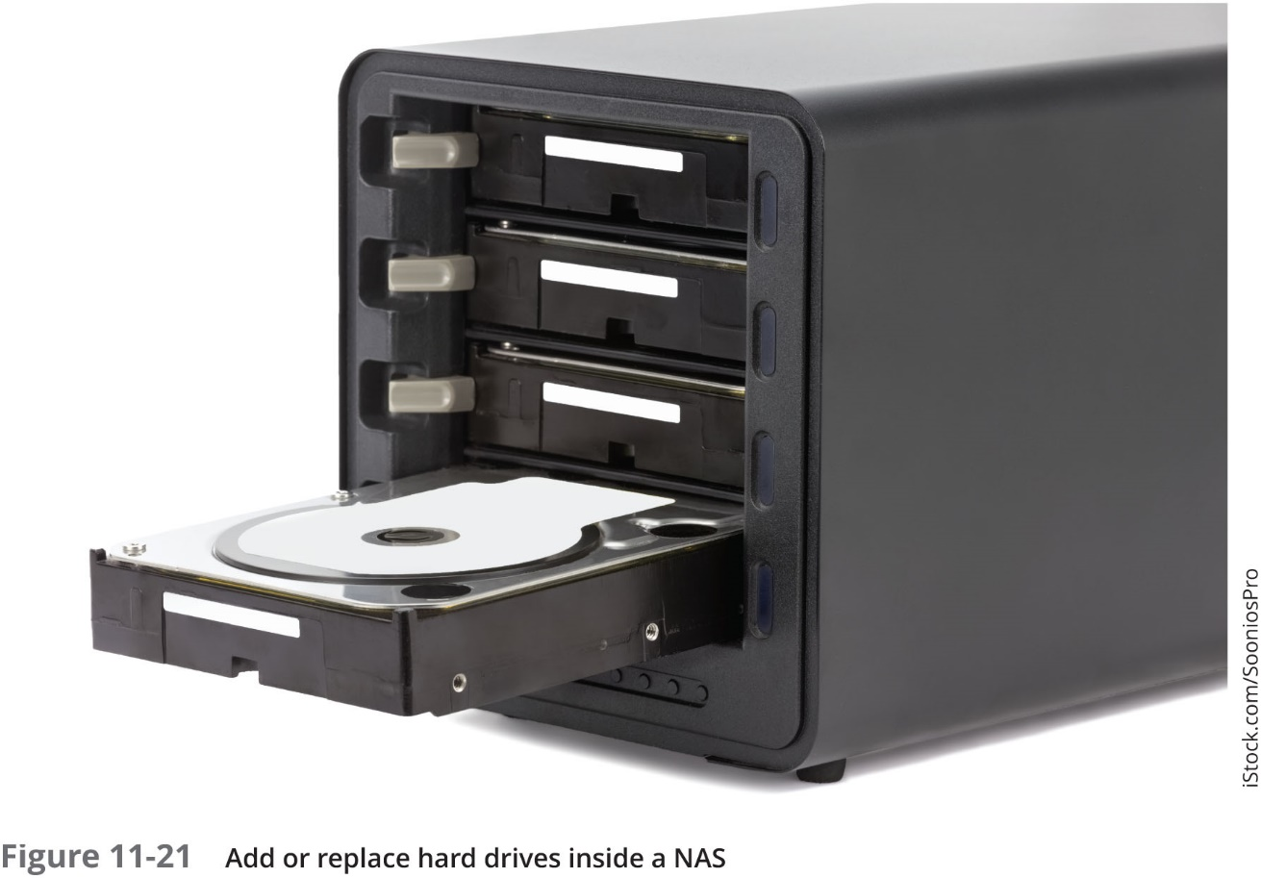
Data Backup and Storage

Slide 51
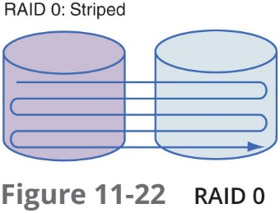
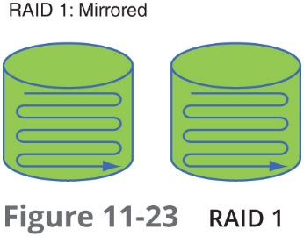
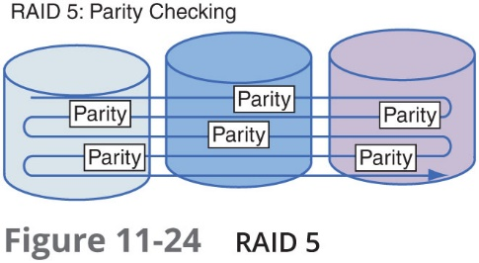
Data Backup and Storage

Slide 52
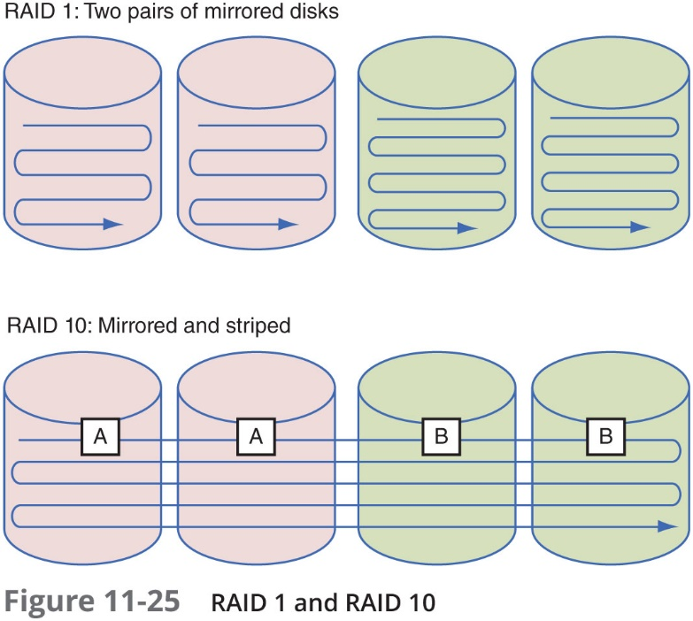
Data Backup and Storage

Slide 53
Data Backup and Storage
SAN (storage area network):
A network of storage devices that communicate directly with each other and with other networks
Uses a type of architecture that is similar to mesh topology, which is the most fault-tolerant
SANS use one of these technologies:
FC (Fibre Channel)
FCoE (Fibre Channel over Ethernet)
iSCSI (Internet SCSI)
IB (InfiniBand)

Slide 54
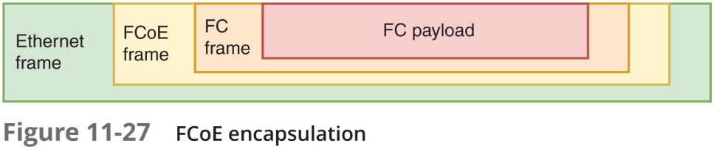
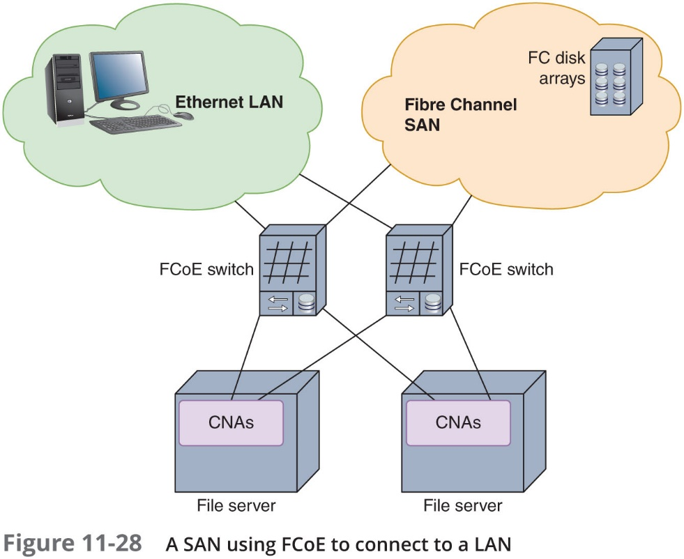
Data Backup and Storage

Slide 55
Data Backup and Storage
ASAN can be installed in a location separate from the LAN it serves
SANs are highly scalable and have:
A very high fault tolerance
Massive storage capabilities
Fast data access
SANs are best suited to environments with huge quantities of data that must always be quickly available

Slide 56
Power Management
Part of managing a network is managing power sources to account for outages and fluctuations
Power surges can cause serious damage to sensitive computer equipment
Arm yourself with an understanding of:
The nature of an electric circuit
Electrical components that manage electricity
Power flaws that can damage your equipment:
Surge—Momentary increase in voltage due to lightning strikes, solar flares, or electrical problems
Noise—Fluctuation in voltage levels caused by other devices on the network or EMI
Brownout—Momentary decrease in voltage; also known as a sag
Blackout—Complete power loss

Slide 57
Power Management
UPS (uninterruptible power supply)
A battery-operated power source directly attached to devices and to a power supply
Prevents undesired fluctuations of power from harming the device or interrupting its services
Two UPS categories:
Standby UPS—Provides continuous voltage to a device by switching to the battery when it detects a loss of power from the wall outlet
Online UPS—Uses the AC power from the wall outlet to continuously charge its battery, while providing power to the device through its battery

Slide 58
Power Management
To decide which UPS is right for your network, consider the following:
Amount of power needed
Period of time to keep a device running
Line conditioning
Cost
Testing UPSs with your equipment is an important part of the decision-making process
Some manufacturers will provide a warranty and let you test the UPS
Power redundancy:
Dual power supplies
Redundant power circuits

Slide 59
Power Management
Generators:
A backup power source, providing power redundancy in the event of a total blackout
Can be powered by diesel, liquid propane gas, natural gas, or steam
Generators can be combined with large UPSs to ensure that clean power is always available
If an organization relies on a generator, fuel levels and quality should be checked regularly

Slide 60
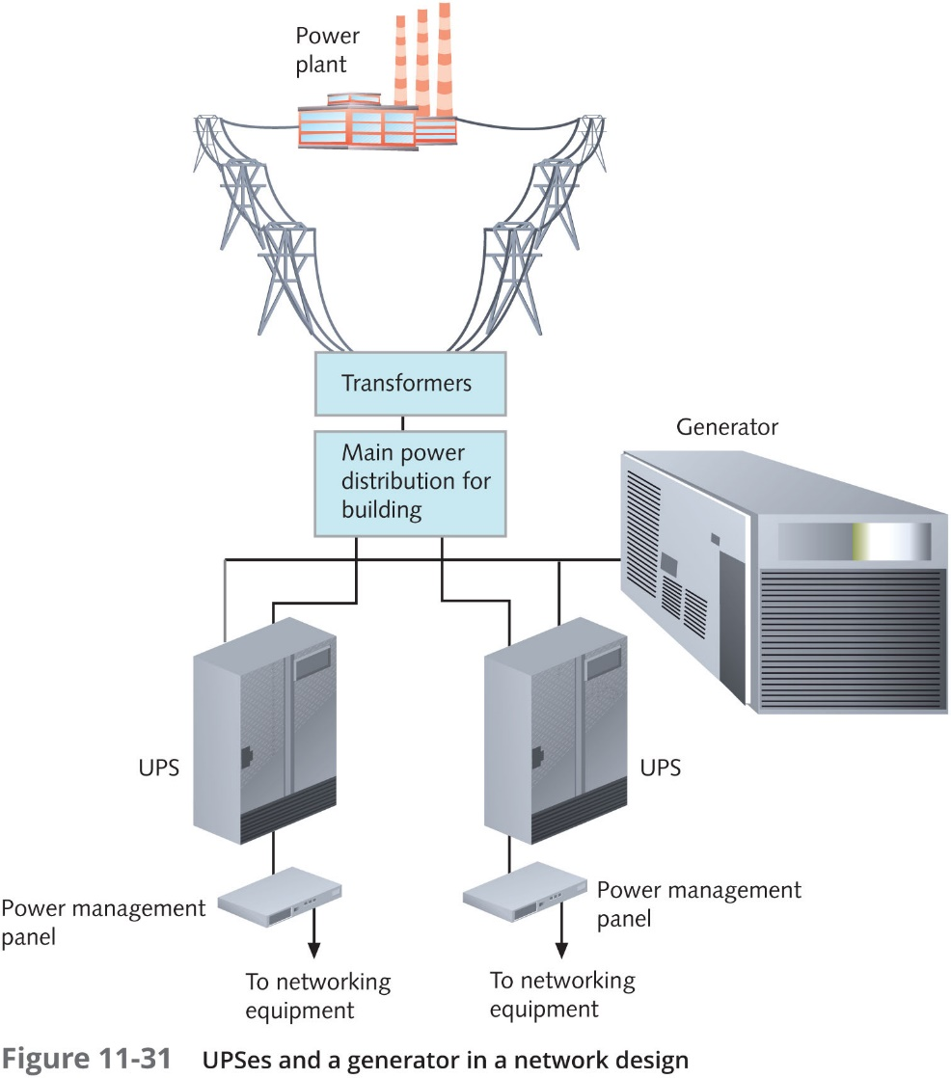
Power Management

Slide 61
Response and Recovery
Disasters and security breaches to happen
Training and preparation can make all the difference in your company’s ability to respond and adapt to these situations
Incident:
Any event that has adverse effects on a network’s availability or resources
Could be a security breach, infection, or an environmental issue
Disaster
An extreme type of incident involving a network outage that affects more than a single system

Slide 62
Incident Response Policies
Incident response policies:
Specifically define the characteristics of an event that qualifies as a formal incident
Defines the steps that should be followed
A six-stage process (actually begins before the incident occurs):
Preparation
Detection and identification
Containment
Remediation
Recovery
Review

Slide 63
Incident Response Policies
Response policy should identify members of a response team
Responsibilities assigned to each member should be clearly spelled out in the policy
Suggested team roles include:
Dispatcher
Technical support specialist
Manager
Public relations specialist

Slide 64
Disaster Recovery Planning
Disaster recovery
Process of restoring critical functionality, data affecting more than single system or a limited group of users
Disaster recovery plan:
Accounts for the worst-case scenarios
Goal is to ensure business continuity (ability to continue doing business with least amount of interruption)

Slide 65
Disaster Recovery Planning
Disaster recovery plan should include:
Contact names and phone numbers for emergency coordinators
Details on which data and servers are being backed up, how frequently backups occur, where backups are kept, and how backed-up data can be recovered in full
Details on network topology, redundancy, and agreements with national service carriers
Regular strategies for testing the disaster recovery plan
A plan for managing the crisis
Having a comprehensive disaster recovery plan
Lessens the risk of losing critical data
Makes potential customers and insurance providers look more favorably on your organization

Slide 66
Disaster Recovery Contingencies
Cold site:
Components necessary to rebuild network exist
Not appropriately configured, updated, or connected
Warm site:
Components necessary to rebuild network exist
Some appropriately configured, updated, and connected
Hot site:
Components exist and match network’s current state
All appropriately configured, updated, and connected

Slide 67
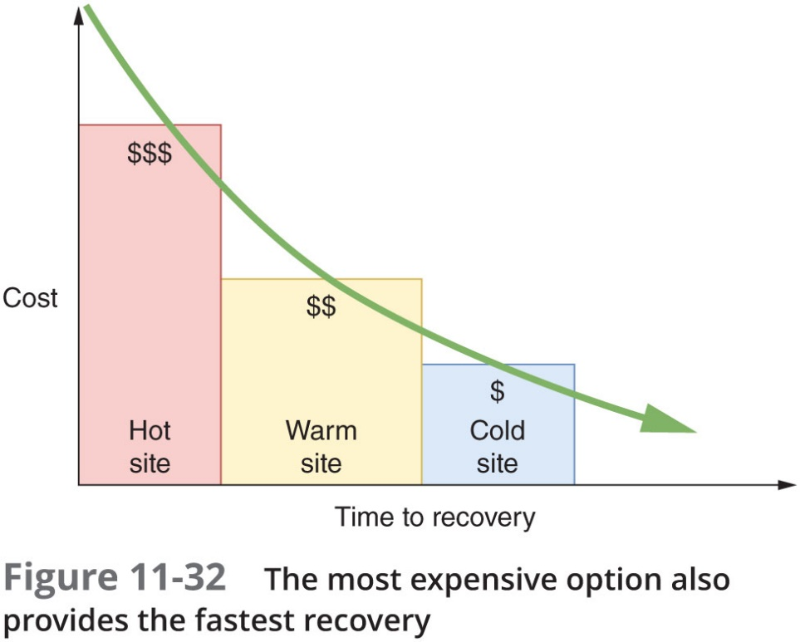
Disaster Recovery Contingencies

Slide 68
Data Preservation
Some incidents may require data to be collected in such a way that it can be presented in a court of law
One or more first responders may take charge in these cases
Every IT technician should be familiar with the following procedures:
Secure the area
Document the scene
Monitor evidence and data collection
Protect the chain of custody
Monitor transport of data and equipment
Create a report

Slide 69
Chapter Summary
Network management refers to the assessment, monitoring, and maintenance of all aspects of a network
A network monitor is a tool that continually monitors network traffic
Virtually every condition recognized by an OS can be recorded
A list of managed objects and their descriptions is kept in the MIB
A baseline is a report of the network’s normal state of operation and might include a range of acceptable measurements
Traffic shaping involves manipulating characteristics of packets, data streams, or connections to manage the type and amount of traffic traversing a network

Slide 70
Chapter Summary
QoS is a group of techniques for adjusting the priority a network assigns to various types of transmissions
The term availability refers to how consistently and reliably a file, system, or other network resource can be accessed by authorized personnel
A key factor in maintaining the availability of network resources is fault tolerance
A full backup backs up everything
A UPS is a battery-operated power source directly attached to one or more devices and to a power supply
Incident response policies specifically define the characteristics of an event that qualifies as a formal incident and the steps that should be followed

Slide 71
Chapter Summary
Disaster recovery is the process of restoring critical functionality and data after an outage that affects more than a single system or a limited group of users
At a cold site, computers, devices, and connectivity necessary to rebuild a network exist
During some incidents, data will need to be collected in such a way that it can be presented in a court of law for the purpose of prosecuting an instigator of illegal activity

Slide 72








@schoolisbinus
http://sis.binus.ac.id
schoolisbinus
SIS Binus
http://www.facebook.com/schoolisbinus
schoolisbinus@binus.ac.id
http://www.drone-maniac.com/news-drone-maniac-more-and-more-popular/thank-you/

